Slide 1
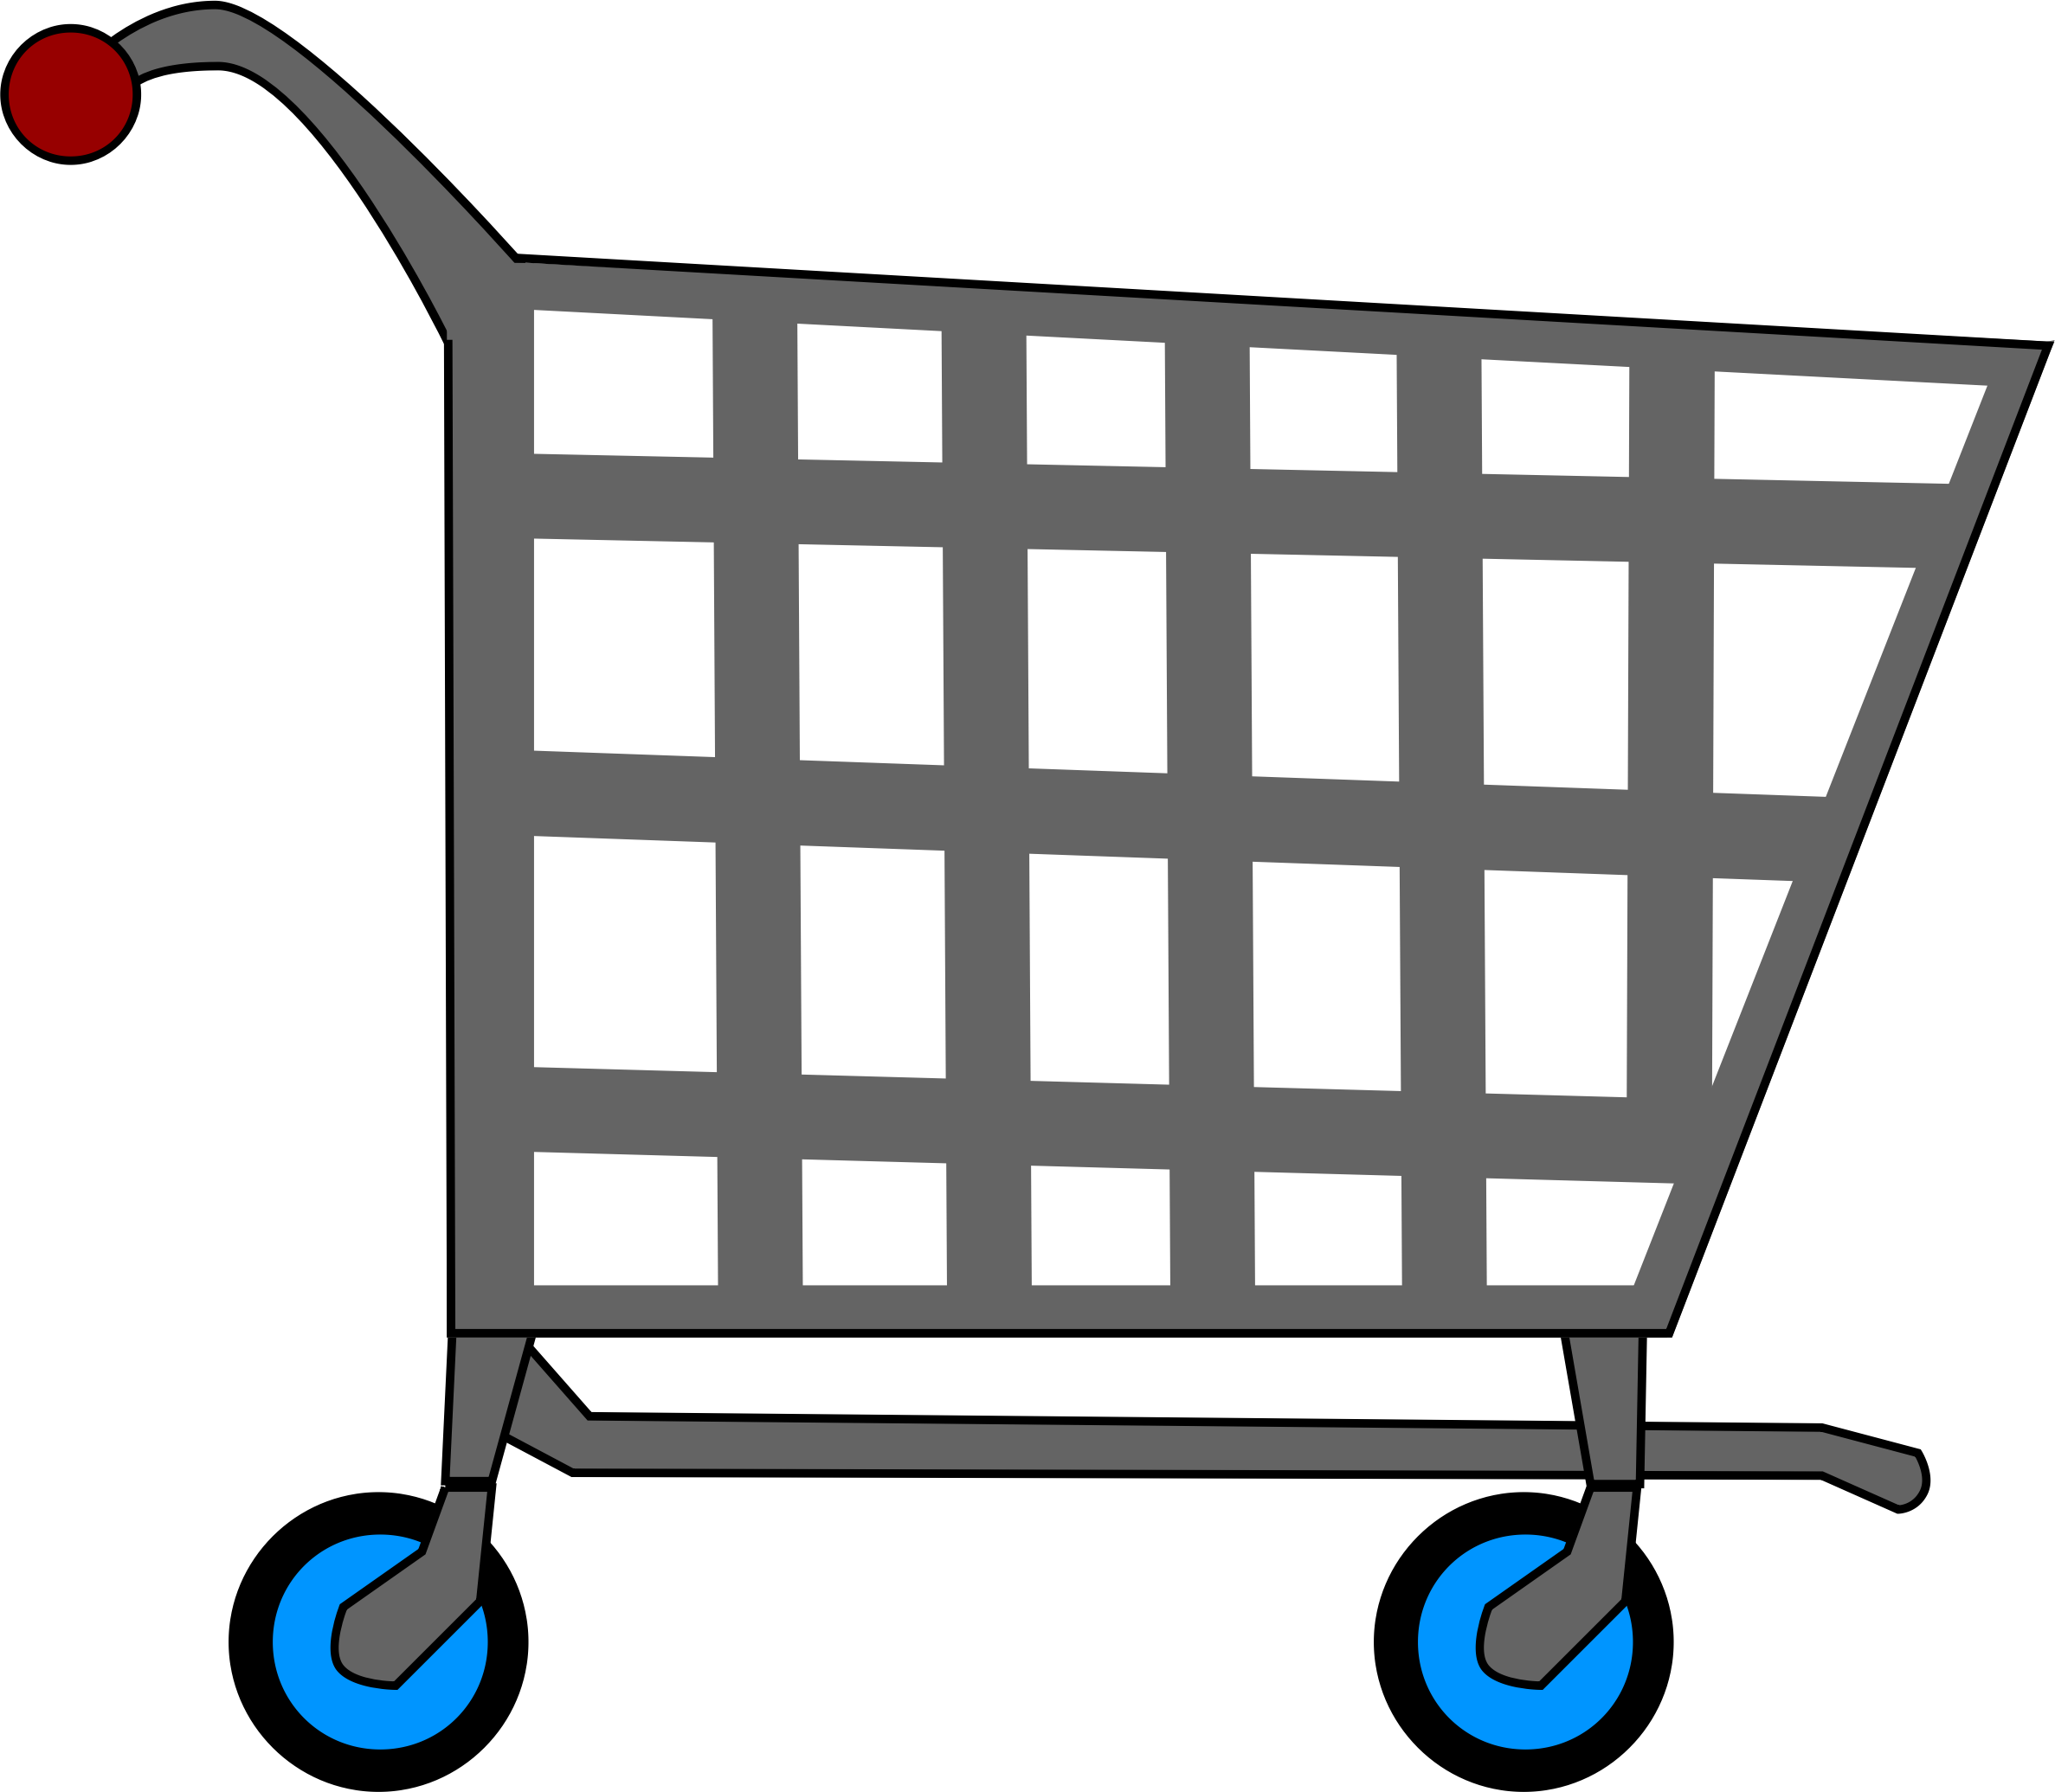
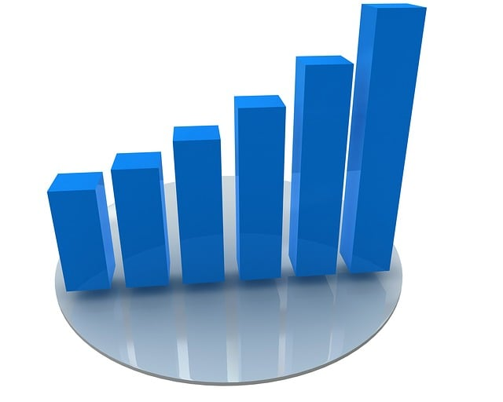

Data Visualization Dashboard for Consumer Behavior Analysis
“Unveiling Consumer Insights Through Data and Machine Learning”
Team Members:
Vishesh Bharuka
Kishan Kumar Parida
Sujan DM

Slide 2


Introduction
Our project analyzes consumer behavior to uncover actionable insights for decision-making.
Key Objectives:
Understand customer demographics and purchasing trends.
Segment customers using clustering techniques.
Build predictive models for purchase behaviors.
Identify anomalies in transaction data.
The insights will be integrated into an interactive Power BI dashboard.

Slide 3
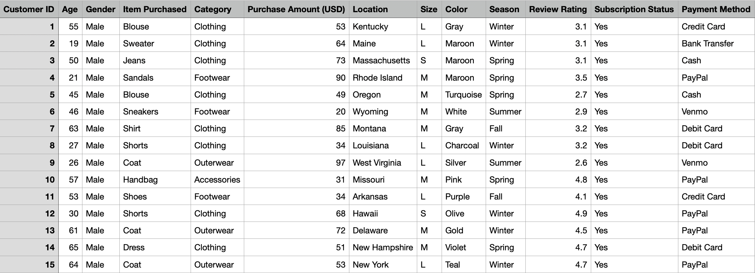
Dataset overview
Source : Consumer Behaviour Dataset
Details:
Rows: Over 4000 transactions.
Columns: 15 features, including:
Demographics: Age, gender, customer ID.
Purchase Details: Item purchased, purchase amount, category.
Behavioral Data: Payment method, review rating, discount applied.
Preprocessing steps:
Missing values: Minimal and addressed by imputation or removal.
Duplicates: Removed to ensure data integrity.
Standardized column names for uniformity.

Slide 4
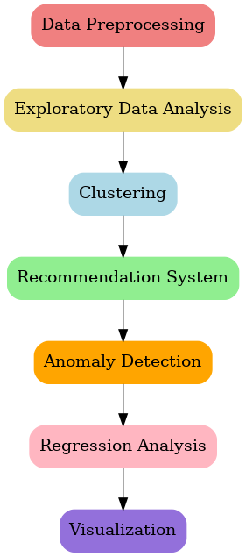
WORKFLOW
Data Preprocessing: Cleaned and prepared data for analysis.
Exploratory Data Analysis (EDA): Visualized trends and patterns.
Clustering: Segmented customers using K-Means.
Recommendation System: Built collaborative filtering model for personalized suggestions.
Anomaly Detection: Flagged unusual transactions using Isolation Forest.
Regression Analysis: Predicted purchase amounts with Random Forest.
Visualization: Developed comprehensive charts for insights.

Slide 5
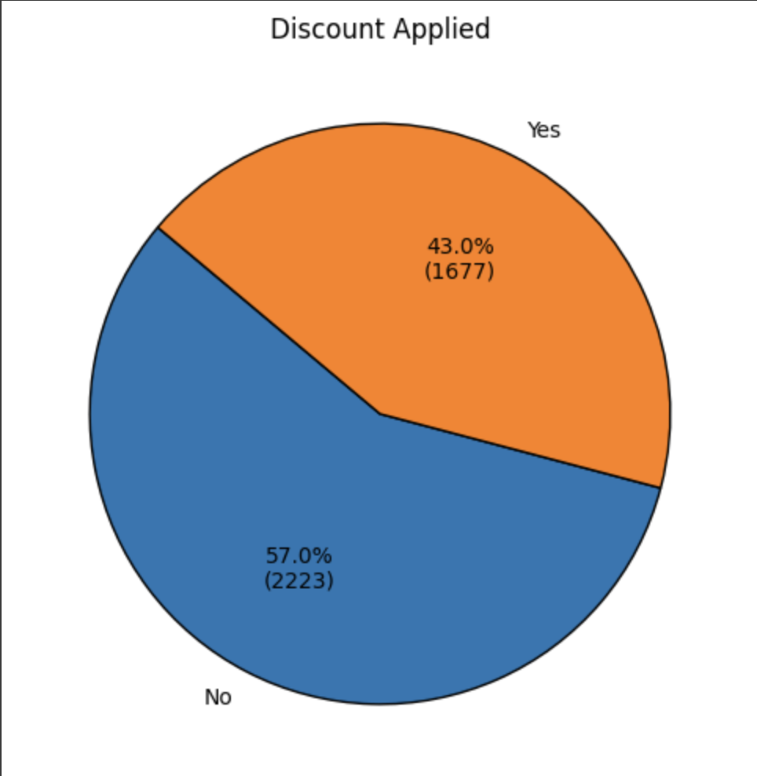
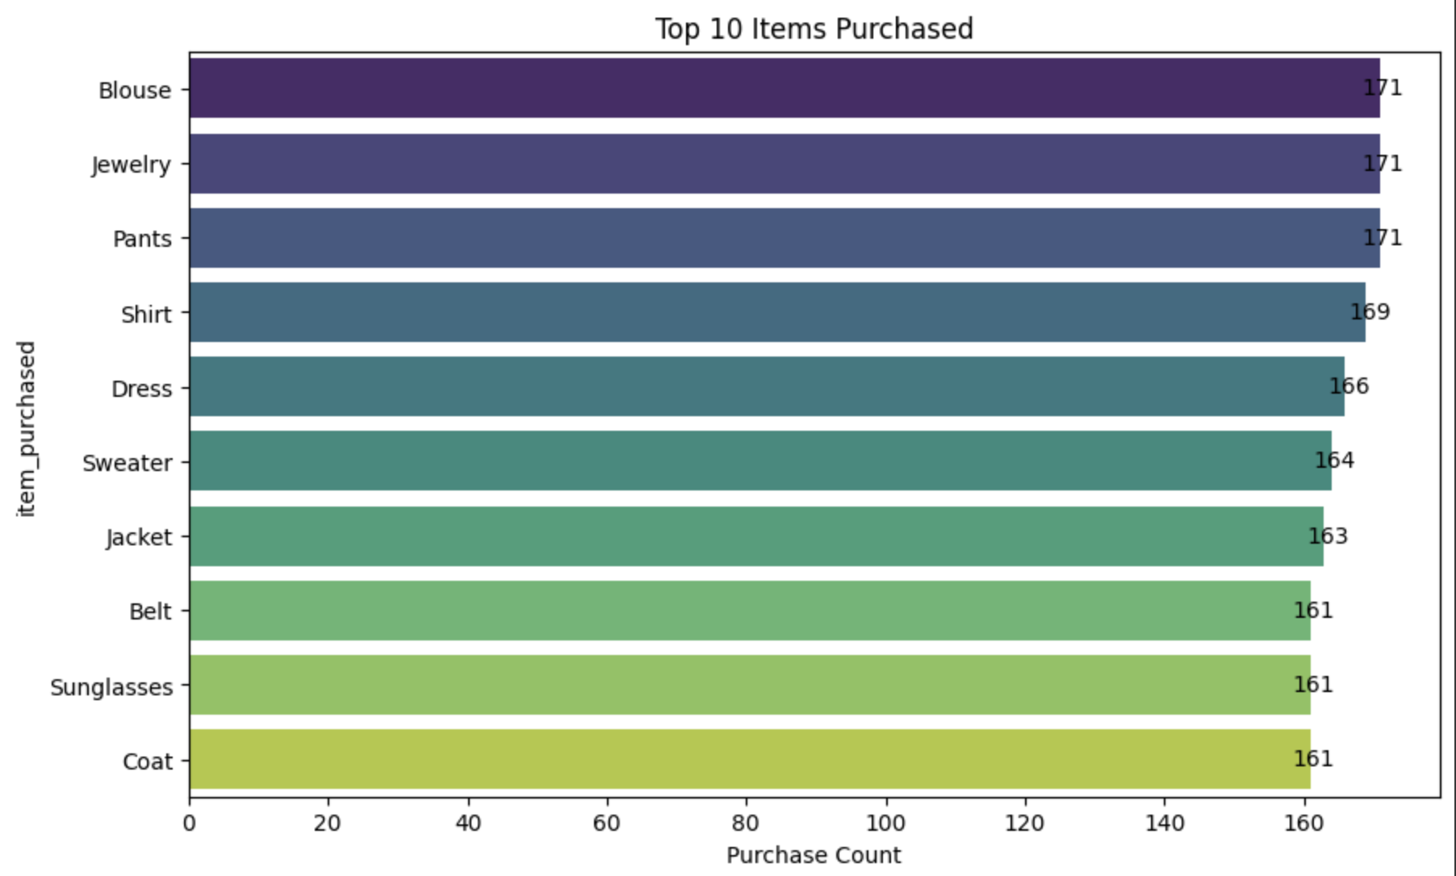
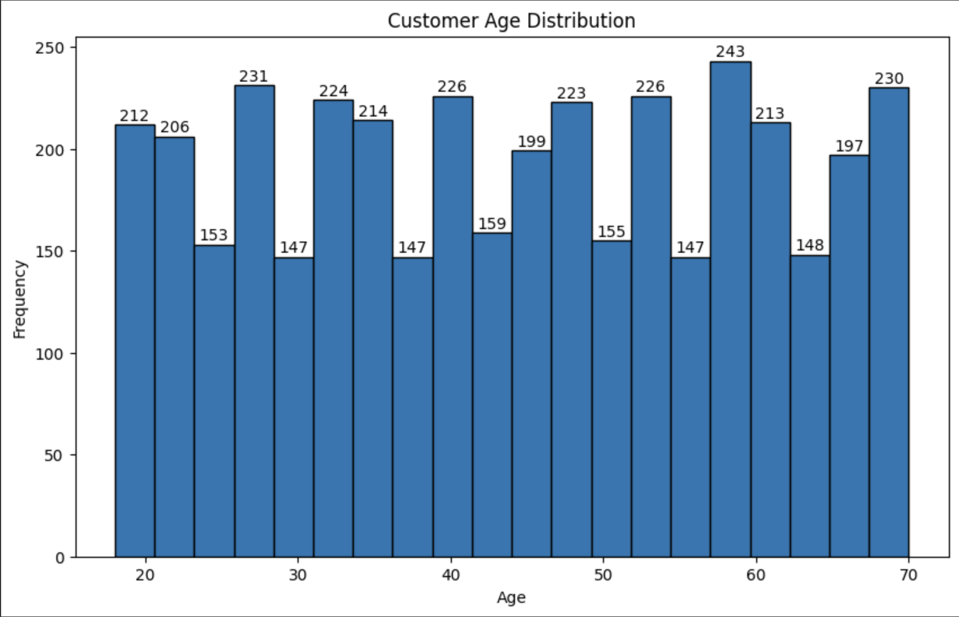
EXPLORATORY DATA ANALYSIS
Key Insights:
Age Distribution: Majority of customers fall in the 25–49 age range. Histogram revealed a normal-like distribution.
Top Products: Clothing and accessories are the most purchased categories. Products like blouses and pants dominate.
Spending Patterns: Average purchase amount: $59.76. Categories like "Clothing" see higher spending.
Review Ratings: Average rating: 3.75 (skewed toward 3–4 stars).
Discount Influence: 43% of purchases involved discounts, showing their significance.

Slide 6
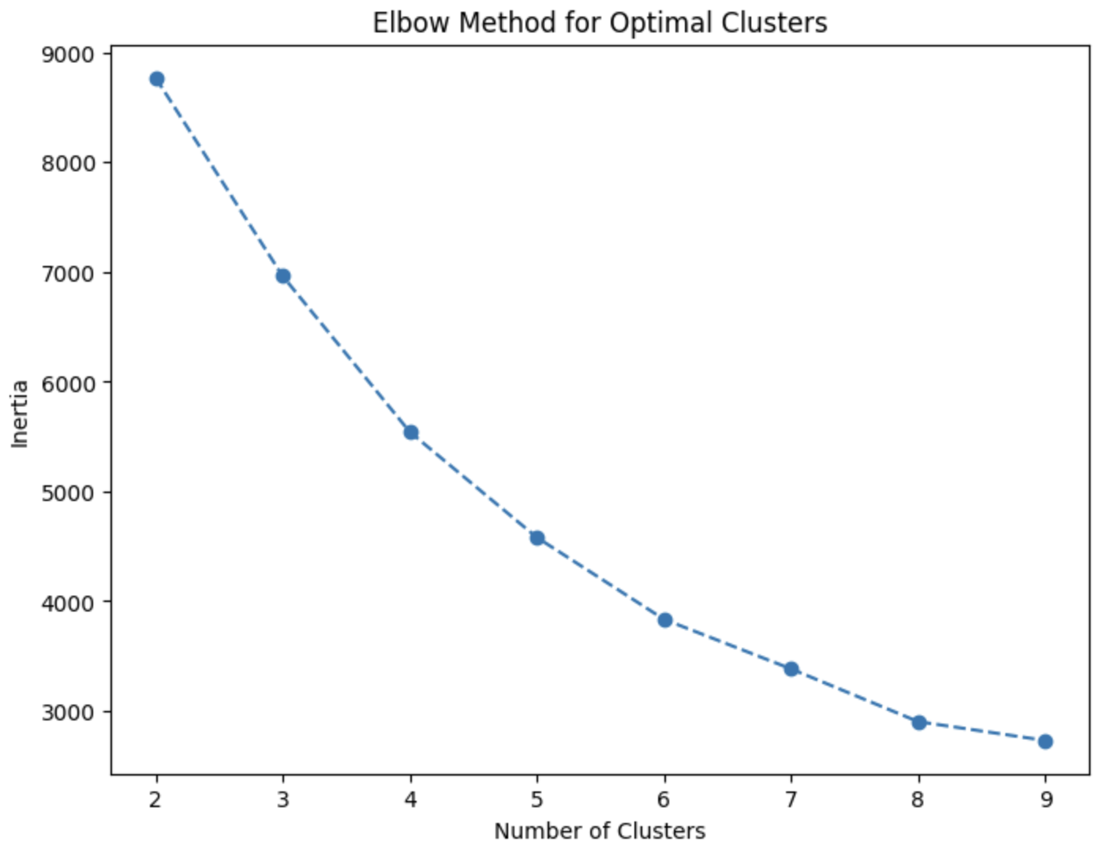
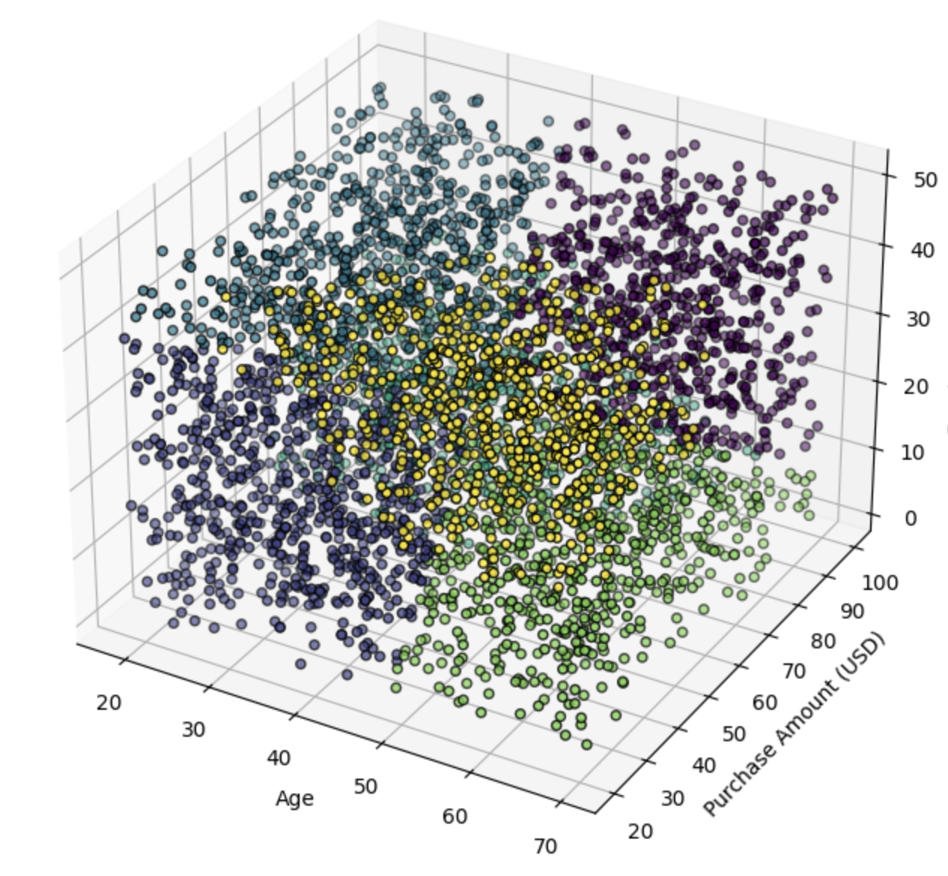
CUSTOMER SEGMENTATION WITH K-MEANS
Objective: Group customers with similar behavior into segments.
Approach: 1. Features: Age, purchase amount, and previous purchases. 2. Scaling: StandardScaler used for normalization. 3. Elbow Method: Determined optimal clusters as 6.
Results: Cluster analysis revealed distinct segments: 1. Cluster 1: Young, low spenders with few purchases. 2. Cluster 2: Middle-aged, high spenders, frequent buyers. 3. Others: Varying age and spending behavior.
Business Impact: Personalized marketing strategies for each segment.

Slide 7
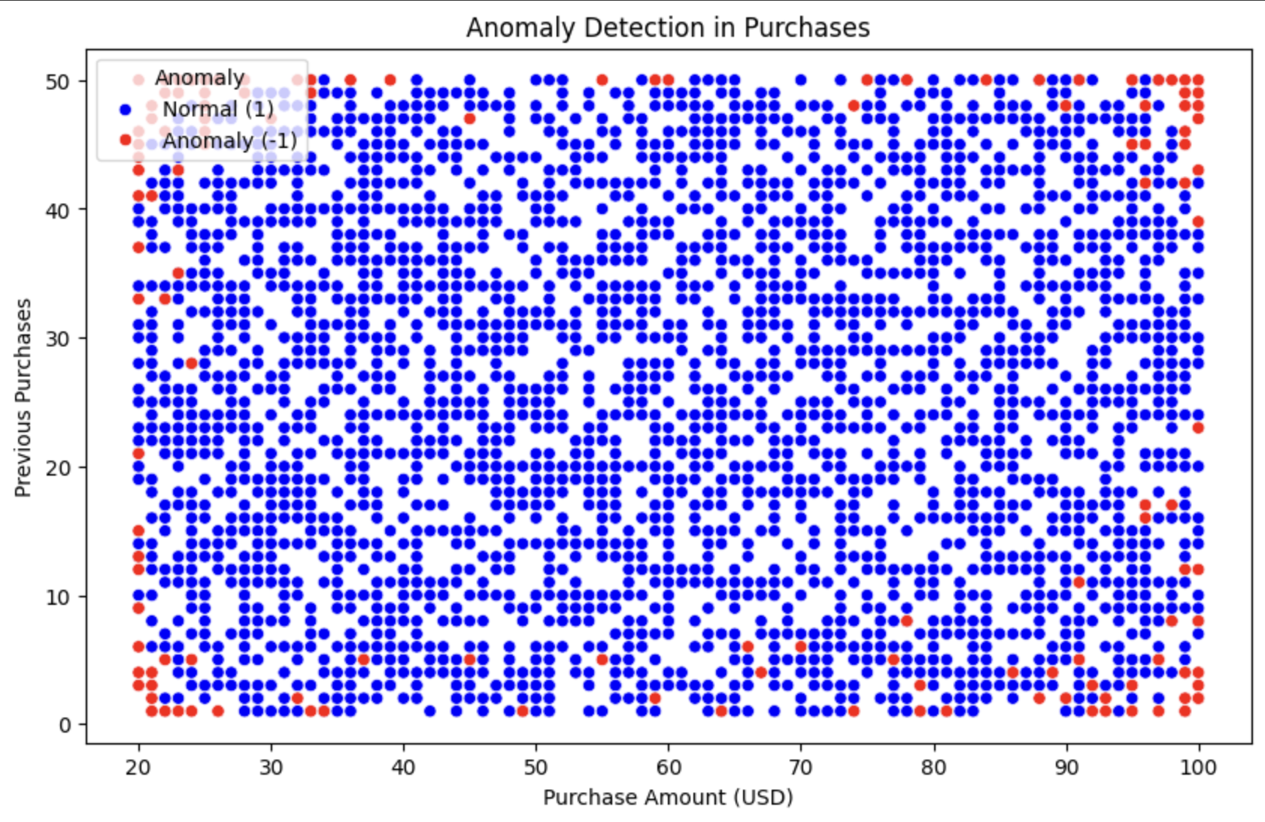
ANAMOLY DETECTION WITH ISOLATION FOREST
Objective: Detect unusual transactions (potential fraud or outliers).
Approach:
1. Used Isolation Forest with a contamination rate of 5%.
2. Features: Purchase amount, review rating, and previous purchases.
Results:
1. Identified 5% of transactions as anomalies.
2. Majority of anomalies were high-value or irregularly frequent purchases.
Business Impact: Improved fraud detection and transaction monitoring.

Slide 8
Recommendation system
Objective: Suggest products to customers based on past behavior.
Approach: 1. Collaborative filtering using Singular Value Decomposition (SVD). 2. Inputs: Customer ID, item purchased, and review rating. 3. Evaluation: RMSE for accuracy.
Results: Example recommendations for Customer 3900: 1. Product A (score: 4.9) 2. Product B (score: 4.8) 3. Product C (score: 4.7) Improved customer retention through personalization.

Slide 9
PREDICTING PURCHASE AMOUNTS USING REGRESSION ANALYSIS
Objective: Estimate purchase amounts based on customer data.
Approach: 1. Features: Age, review rating, and previous purchases. 2. Model: Random Forest regression. 3. Evaluation: R² score and Mean Absolute Error (MAE).
Results: Predicted values added to the dataset for future use. Model accurately predicted purchase trends for most customers.

Slide 10
RESULTS AND ACHIEVEMENTS
Insights Gained: 1. Demographics: Middle-aged customers spend the most. 2. Discounts: Increase purchase frequency significantly. 3. Popular products: Blouses, pants, and shirts.
Model Achievements: 1. Clustering: Six distinct customer segments. 2. Recommendation System: Personalized suggestions with high accuracy. 3. Anomaly Detection: Identified potential fraud cases. 4. Regression: Accurate predictions of purchase amounts.
Business Impact: 1. Enhanced customer targeting. 2. Inventory planning improvements. 3. Fraud prevention strategies.

Slide 11
POWER BI DASHBOARD
Objective: Provide interactive and real-time insights into consumer behavior.
Features: 1. Customer Demographics: Filters for age groups, gender, and regions. 2. Purchase Trends: Monthly sales trends by category. Average spending by customer segments. 3. Top Products and Categories: Highlighting popular products with detailed purchase patterns. 4. Anomaly Insights: Visualization of flagged transactions for potential fraud. 5. Segmentation Insights: Drill-down by clusters for targeted marketing strategies. 6. Performance Metrics: Key KPIs like total sales, average order value, and discount usage.

Slide 12
CONCLUSION
Key Takeaways:
Actionable Insights:
1. Identified high-value customer segments for targeted campaigns. 2. Improved inventory planning with product-specific trends. 3. Enhanced fraud detection through anomaly analysis.
Data-Driven Decisions:
1. Interactive Power BI dashboard enables stakeholders to make informed decisions. 2. Filters and drill-downs offer flexibility for customized analysis.
Impact:
1. Improved customer retention through personalized recommendations. 2. Increased efficiency in resource allocation with predictive analytics. 3. Empowered decision-makers with real-time insights through the dashboard.

